Slide 1
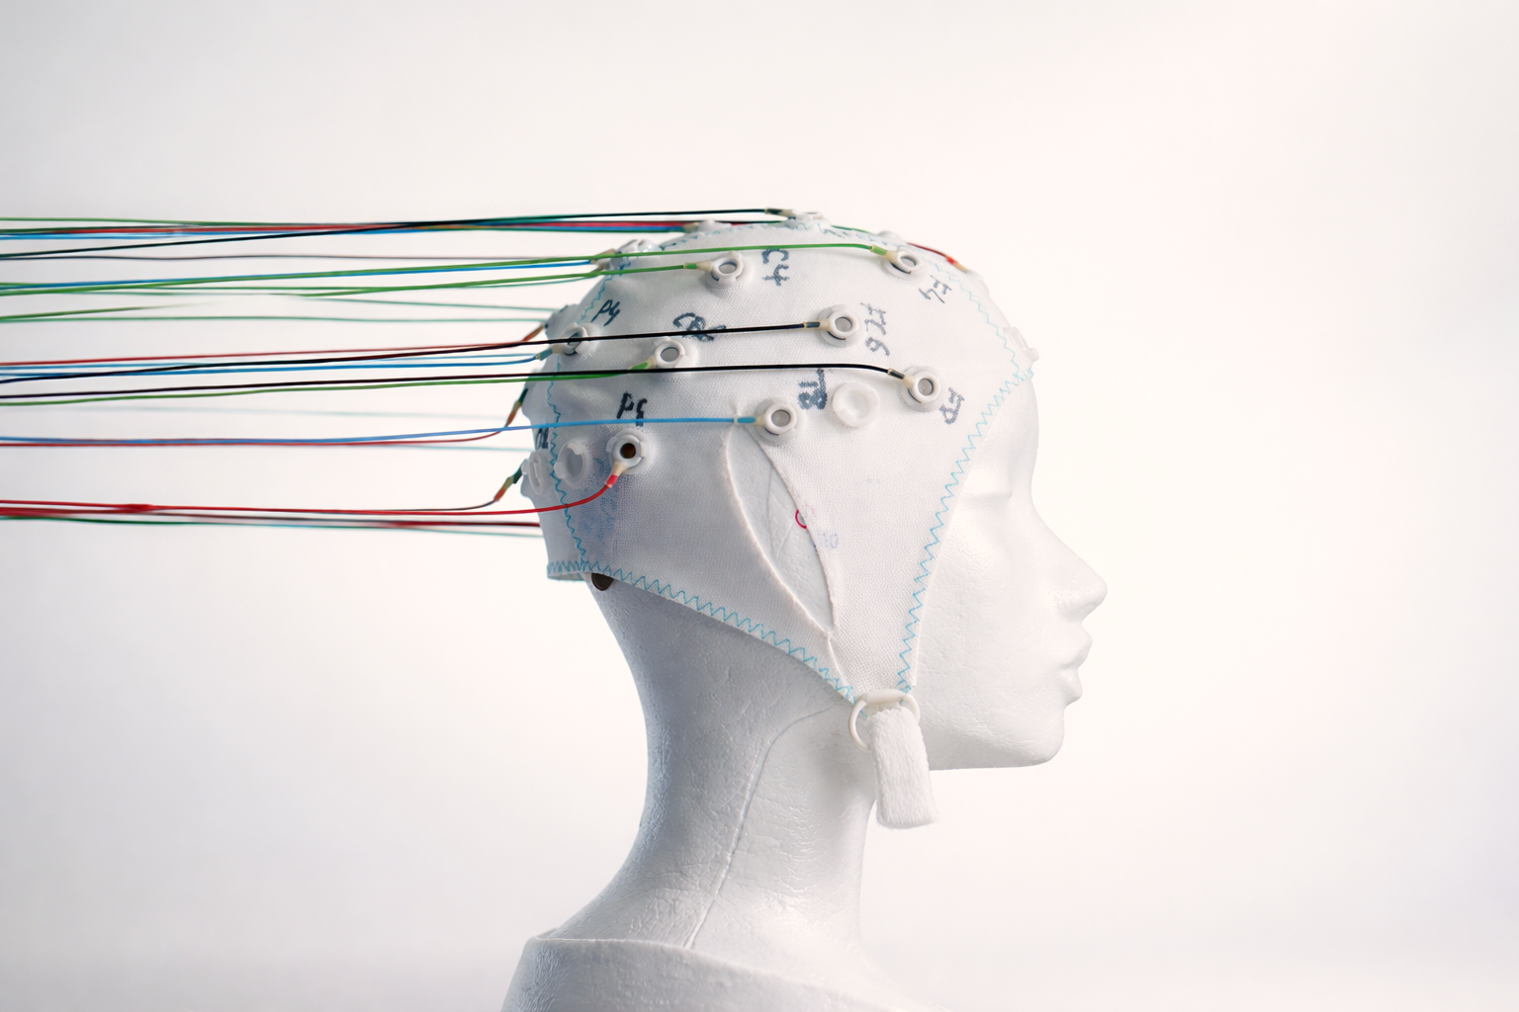
Real-Time EEG-Based Brain-Computer Interface
Applying signal processing for blink detection in game design
ZHAW ACLS – AS25; Trackmodul 1, Kai Aebli

Slide 2
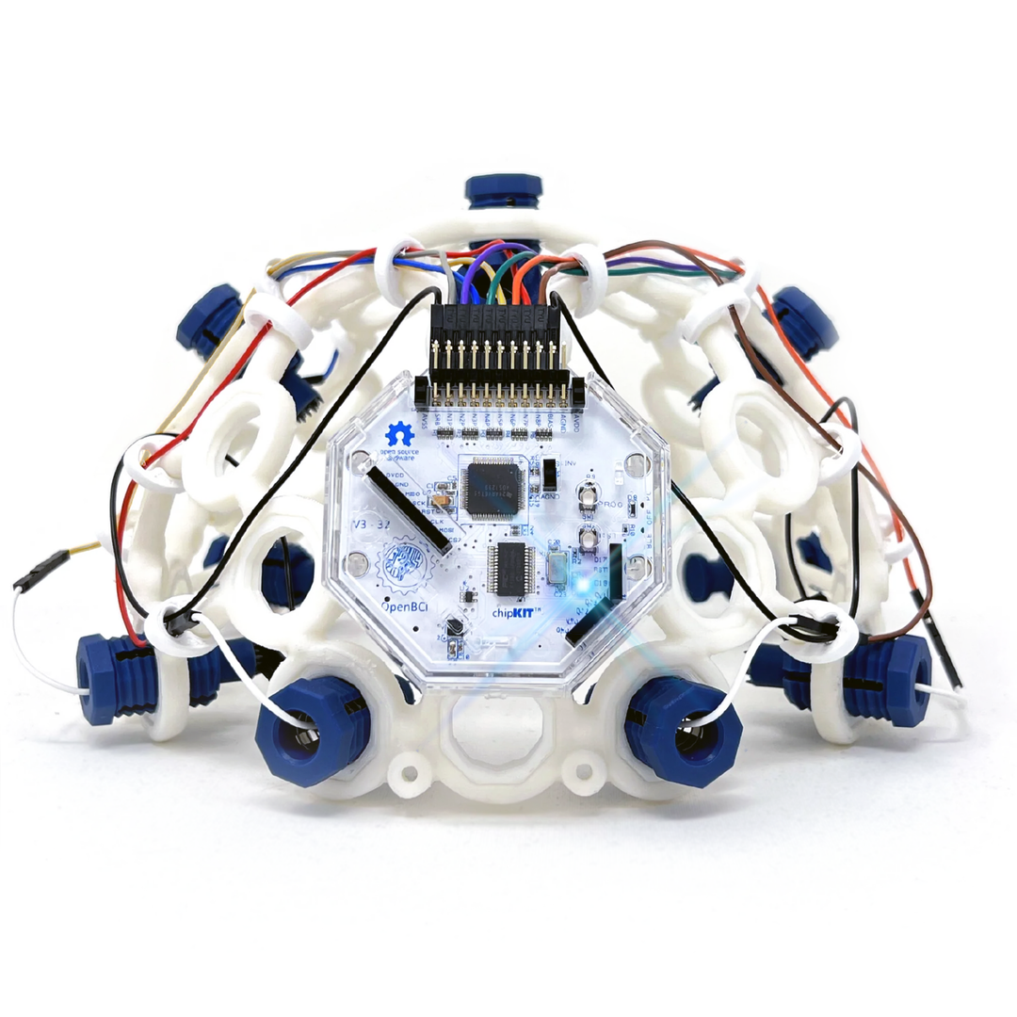
Introduction & Motivation
Objective: Create a «blink-controlled» pong-game
Use of OpenBCI’s Ultracortex EEG headset
Account for variability among different persons
Implement different levels of difficulty
(The Complete Ultracortex, n.d.)

Slide 3
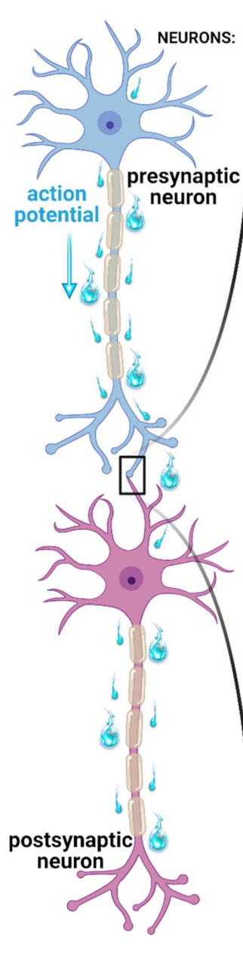
Physiological Background – EEG
Non-invasive measurement of the brain’s electric fields
Electrodes on the skin record voltage potentials
Requires simultaneous activity of large neuron populations
Noise can be induced by external devices or general distractions
(Oleksak et al., 2021)
Notes:
Electroencephalogram
EEG measures the electrical actrivity resulting from neuronal communication
EEG does not measure action potentials but postsynaptic potentials which result from slower currents after neurotransmitter release
For a signal to be detected by EEG, many neurons must fire together

Slide 4
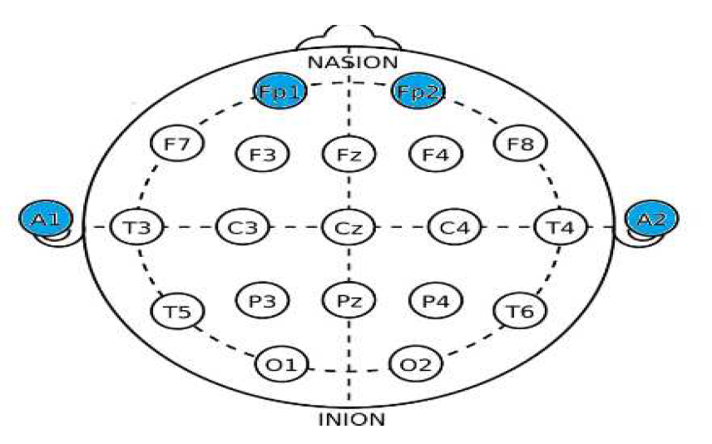
Physiological Background – EEG
Human blinks:
are best detected from the forehead
produce EOG signals rather than EEG signals
are low-frequency signals (< 10 Hz)
appear as sharp spikes in the EEG signal
Brain activity often involves higher frequency signals (e.g., Gamma > 30 Hz)
Baseline activity can be rhythmic and blinks show up as peaks
(Deepu et al., 2024)
Notes:
EOG = Electrooculography → Blinks are artifacts in EOG and not neuronal EEG signals
Eyes act as a dipole (positive cornea, negative retina)
When the eyes close (blink) the eyeballs rotate (Bell's phenomenon) → big voltage spike

Slide 5
Challenges
Various sources of noise:
Environmental
Heart- & Muscle-Activity
Detection of «double-blinks»
Big variability between different persons

Slide 6
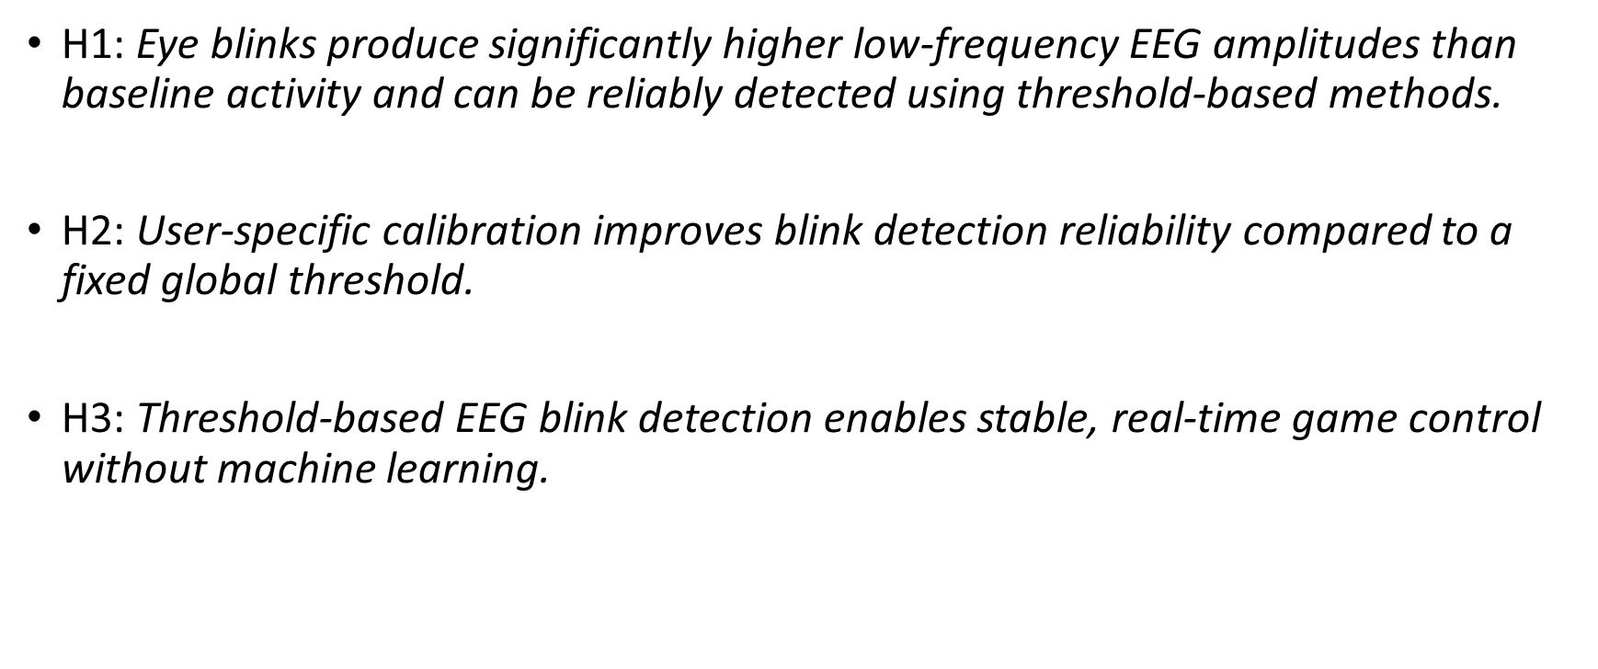
Hypotheses
H1: Eye blinks produce significantly higher low-frequency EEG amplitudes than baseline activity and can be reliably detected using threshold-based methods.
H2: User-specific calibration improves blink detection reliability compared to a fixed global threshold.
H3: Threshold-based EEG blink detection enables stable, real-time game control without machine learning.

Slide 7
Implementation: System Architecture
Backend:
Python + Flask for data streaming, signal processing and blink detection
Frontend:
HTML5 and JavaScript for interface and gameplay
Communication:
REST API for interaction between EEG detector and game logic

Slide 8
Implementation: Signal Acquisition
OpenBCI Cyton board (sampling rate = 250 Hz)
Frontal electrodes (forehead)
Signals averaged across channels
Continuous streaming with sliding buffer

Slide 9
Implementation: Signal Preprocessing
DC offset removal (subtract mean) → zero-centering
Notch filter (50 Hz) to remove power-line noise
Band-pass filter (1-10 Hz) to isolate blink-related signals
Zero-phase filtering to avoid phase distortion
Notes:
DC offset: by time the eeg signal can shift, removing the DC offset helps prevent this
Zero-phase filters forward, then backward and cancels phase distortion
Because digital filters often introduce phase delay
Signal peaks appear shifted in time

Slide 10

Implementation: Blink Detection
Threshold-based detection on preprocessed EEG signal
Absolute signal magnitude is compared to calibrated threshold
Schmitt trigger logic
Blink ON when $signal > threshold$
Blink OFF when $signal < threshold ∗ offfactor$
Cooldown time prevents double triggers
Notes:
Cooldown time was now set to 0.2 seconds as default
Threshold based approach is:
Efficient
Suited for real-time
Robust against limted training data

Slide 11

Implementation: Calibration Procedure
Calibration collects:
Baseline
Blink amplitudes
Threshold computed as:
$Baseline + factor ∗ blinkpeak$
→ User specificity
Notes:
- Factor to reduce blink peaks was set to 0.6

Slide 12
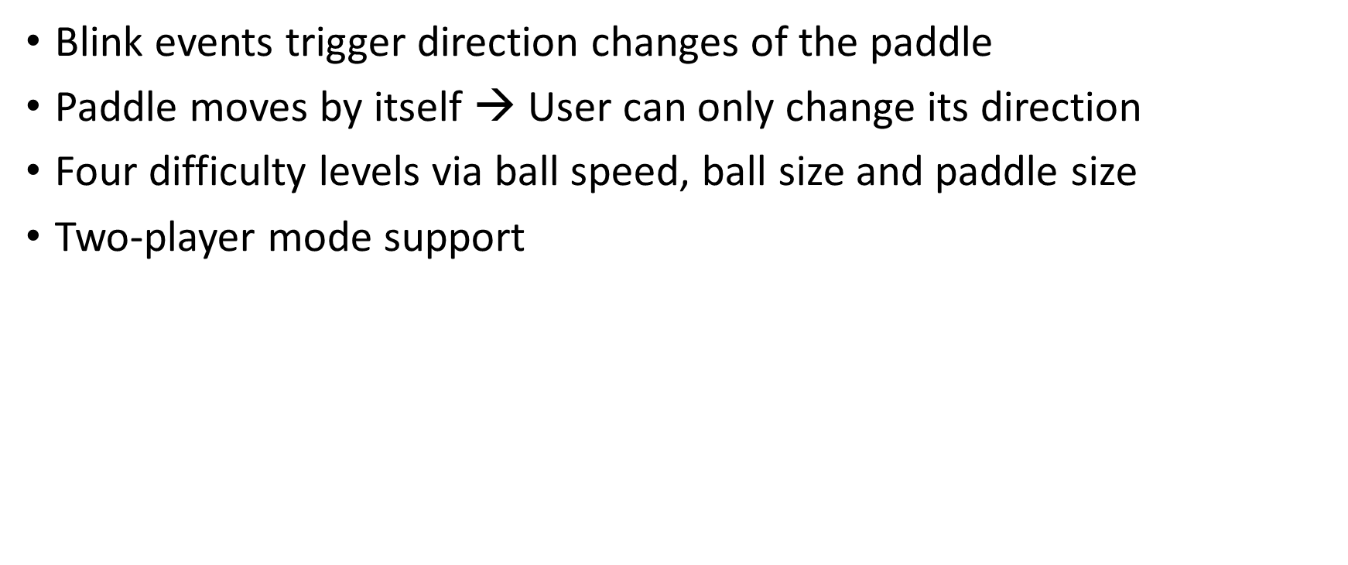
Implementation: Game Integration
Blink events trigger direction changes of the paddle
Paddle moves by itself → User can only change its direction
Four difficulty levels via ball speed, ball size and paddle size
Two-player mode support
EEG
Filtering
Threshold Computing
Blink Detection
Paddle Control
Notes:
- Factor to reduce blink peaks was set to 0.6

Slide 13
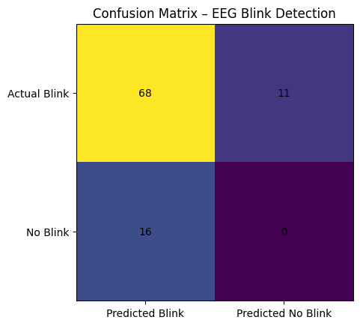
Results
Mean Precision: 0.87
Mean Recall: 0.81
Mean F1-Score: 0.83
7 participants
3 female, 4 male
Age 25 – 64
Notes:
Precision: How many detected blink were actually real blinks (few FP = better Precision)
Recall: How many real blinks were detected (few missed blinks / FN = better Recall)
F1: Balanced measure combining recall and precision → reliable overall detection
Accuracy: Not existent as we can not really measure TN
Ist good that precision is higher because we focused on reducing FP
9 FP and 9 FN came from one test person

Slide 14
Let’s test it

Slide 15
Conclusion
H1: Supported – eye blinks are clearly visible as peaks in the signal and can be detected reliably
H2: Supported – an initial «global» threshold approach did not work
H3: Supported – the pong game can be controlled, but not yet to a really satisfactory degree (dependency on environment & user)
There also seems to be a learning factor

Slide 16
Limitations
Sensitive to environmental noise / general distractions
Requires calibration (very user specific)
Limited sample size (only 7 participants)

Slide 17
References
Biasiucci, A., Franceschiello, B., & Murray, M. M. (2019). Electroencephalography. Current Biology, 29(3), R80–R85. https://doi.org/10.1016/j.cub.2018.11.052
Chandralekha, M., Jayadurga, N. P., Chen, T. M., Sathiyanarayanan, M., Saleem, K., & Orgun, M. A. (2025). A synergistic approach for enhanced eye blink detection using wavelet analysis, autoencoding and Crow-Search optimized k-NN algorithm. Scientific Reports, 15(1), 11949. https://doi.org/10.1038/s41598-025-95119-2
CUPIDO: An Analog Ultra-Low-Power and Contactless Eye Blink Detector for Smart Glasses. (n.d.). Retrieved 14 January 2026, from https://www.research-collection.ethz.ch/entities/publication/80ed2e65-a3ec-4769-afdf-994b5bb11d44
Deepu, S., Chithra, P., Panicker, P., Subodh, P., Binu, P., Dhanya, M., Anusree, V., Archana, M., & Athira, B. (2024). EEG-Based Eye Blink Detection and Interpretation for Human-Computer Interaction and Communication. 2024 International Conference on Brain Computer Interface & Healthcare Technologies (iCon-BCIHT), 263–267. https://doi.org/10.1109/iCon-BCIHT63907.2024.10882341
Oleksak, P., Novotny, M., Patocka, J., Nepovimova, E., Hort, J., Pavlik, J., Klimova, B., Valis, M., & Kuca, K. (2021). Neuropharmacology of Cevimeline and Muscarinic Drugs—Focus on Cognition and Neurodegeneration. International Journal of Molecular Sciences, 22(16), 8908. https://doi.org/10.3390/ijms22168908
The Complete Ultracortex. (n.d.). OpenBCI Shop. Retrieved 14 January 2026, from https://shop.openbci.com/products/the-complete-headset-eeg

